Slide 1

Pedestrian Detection and Direction Prediction

Slide 2
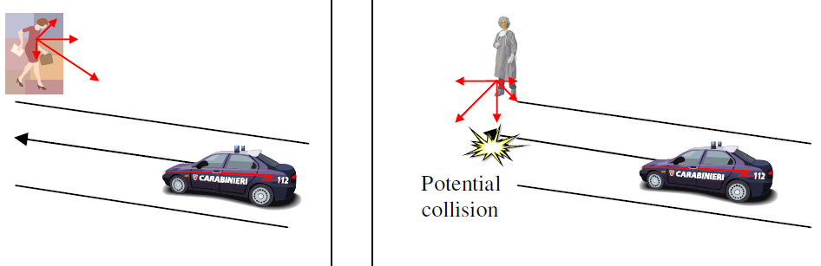
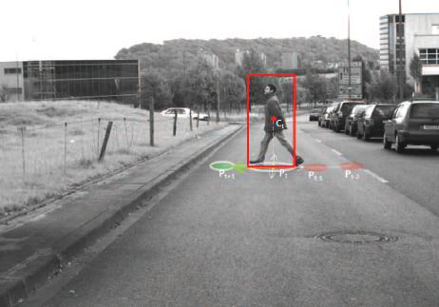
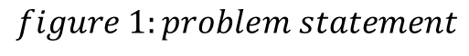
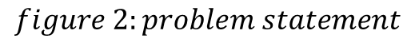
Problem Statement
Pedestrian protection is an essential component of driver assistance systems.
A pedestrian protection system should be able to detect pedestrian motion and in turn indicate to the driver the possibility of collision.
In autonomous vehicles, the system should apply brakes to reduce speed
$$figure 1:problem statement$$
$$figure 2:problem statement$$

Slide 3
Approaches for motion detection
Fourier Transform in 3 dimension:
Fourier transform is the frequency domain representation of the given signal (3-D here)
Image Subtraction:
Optical Flow:
When subsequent frames from the video are subtracted by maximum difference method
Optical flow is the apparent motion of surfaces or objects in a scene, resulting from the motion difference between the observer and a scene

Slide 4
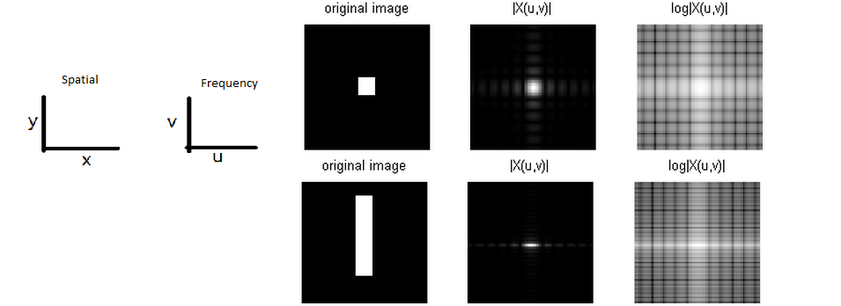
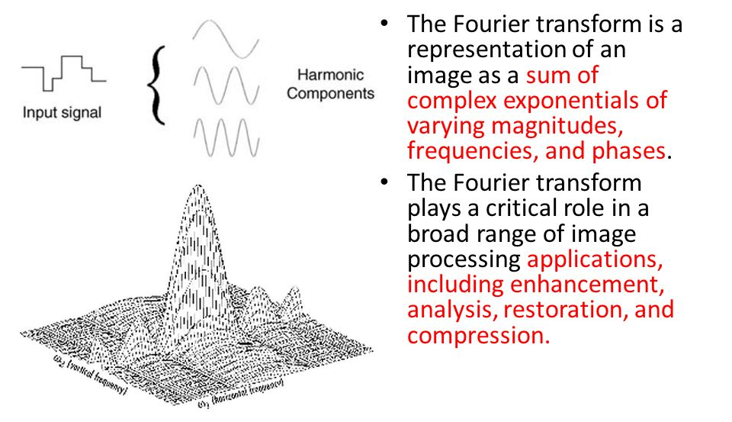
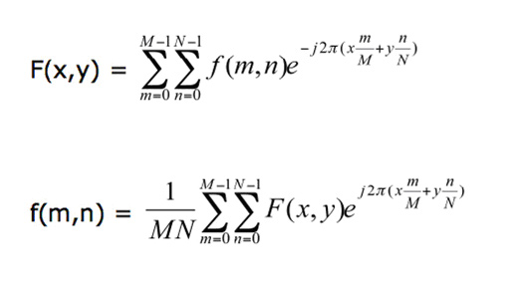
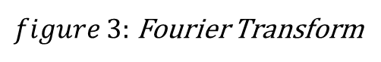
3-D Fourier Transform
$figure 3:$ Fourier Transform

Slide 5
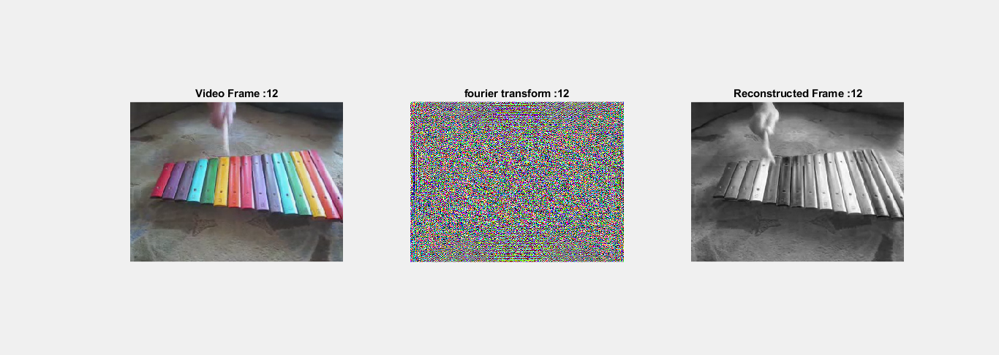

Simulation Result : Fourier Transform
$figure 4:$ Fourier Transform

Slide 6
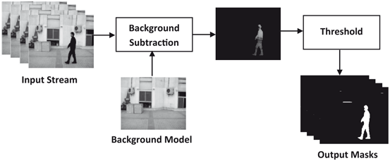
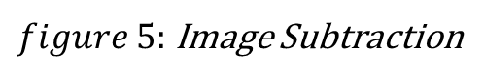
Image Subtraction
Video was fragmented into frames
Subsequent frames were subjected to the following process:
Pre-processing for noise removal
Supplying a background model to subtract background
$figure 5:$ Image Subtraction

Slide 7
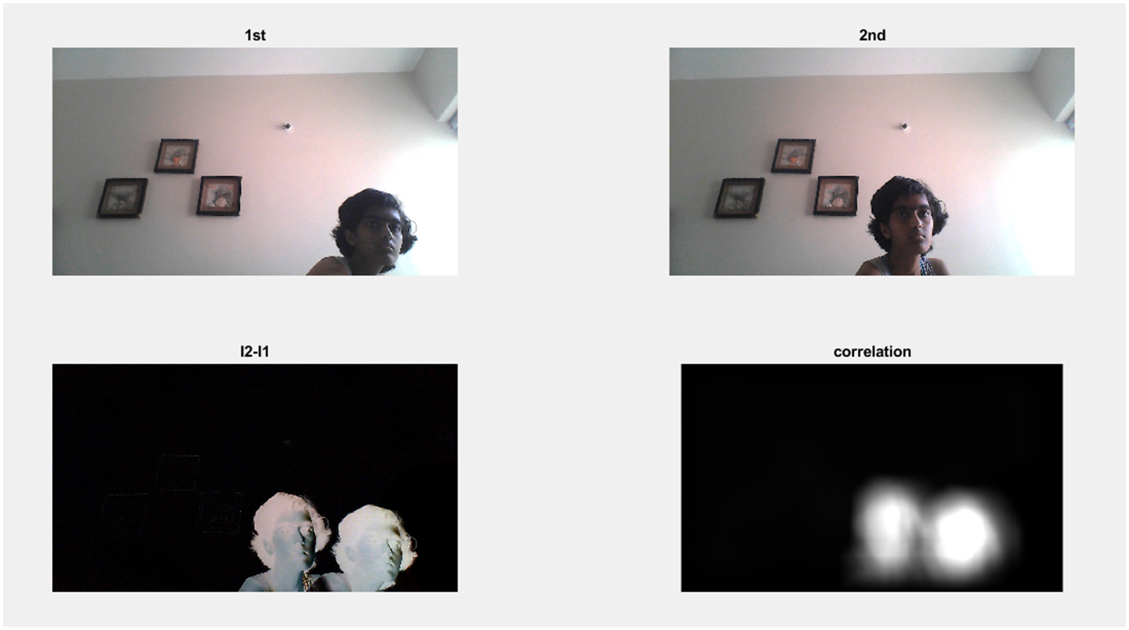
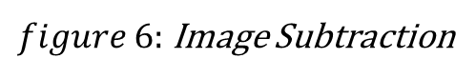
$figure 6:$ Image Subtraction
Subsequent frames were then subtracted to obtain an image that contains the complete motion picture of the object
Using correlation, person was detected, hence, motion area was successfully identified.
Using information from the 1st frame about where the object was initially, direction of the object is predicted.

Slide 8
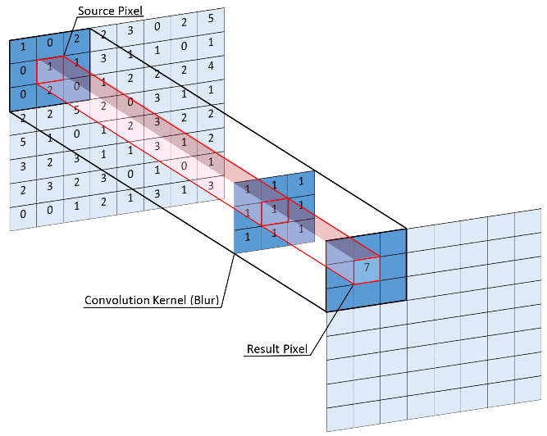
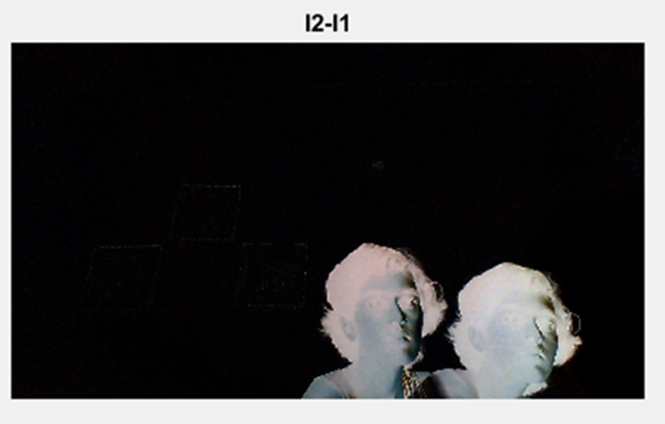

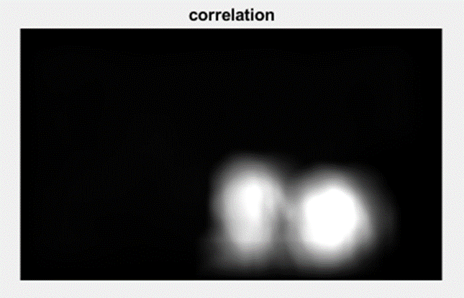
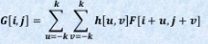
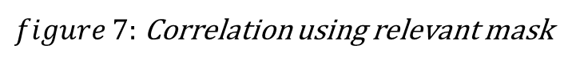
Correlation
$figure 7:$ Correlation using relevant mask

Slide 9
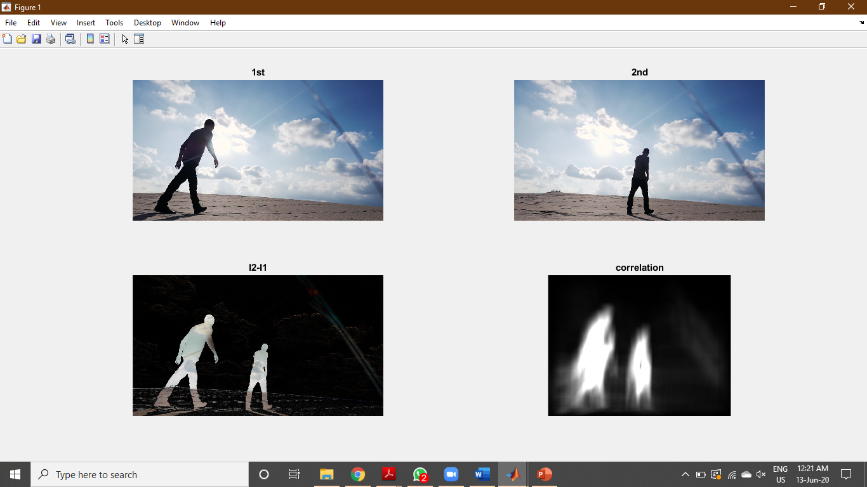
Simulation Result : Image Subtraction and Correlation
$$figure 8:image subtraction and correlation$$

Slide 10
Optical Flow Method
First the video is segmented in different frames.
A motion vector is calculated by finding a correspondence between the video frames at time t and frames at time t − 1, where t is the frame index in a video signal.
Optical flow method to calculate motion vectors: it describes vector field, where a displacement vector is assigned to certain pixel position, that points to where that pixel can be found in another image
Position wise direction and magnitude of vectors are obtained and stored

Slide 11
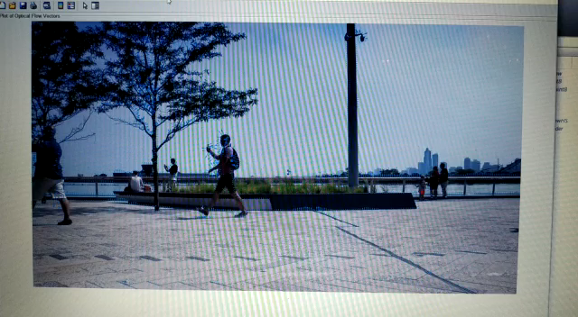

Simulation Result: Optical Flow
$$demo 1 :Pedestrians$$

Slide 12
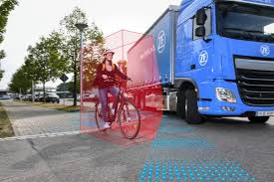
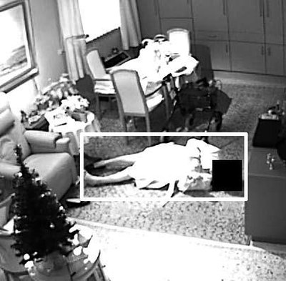
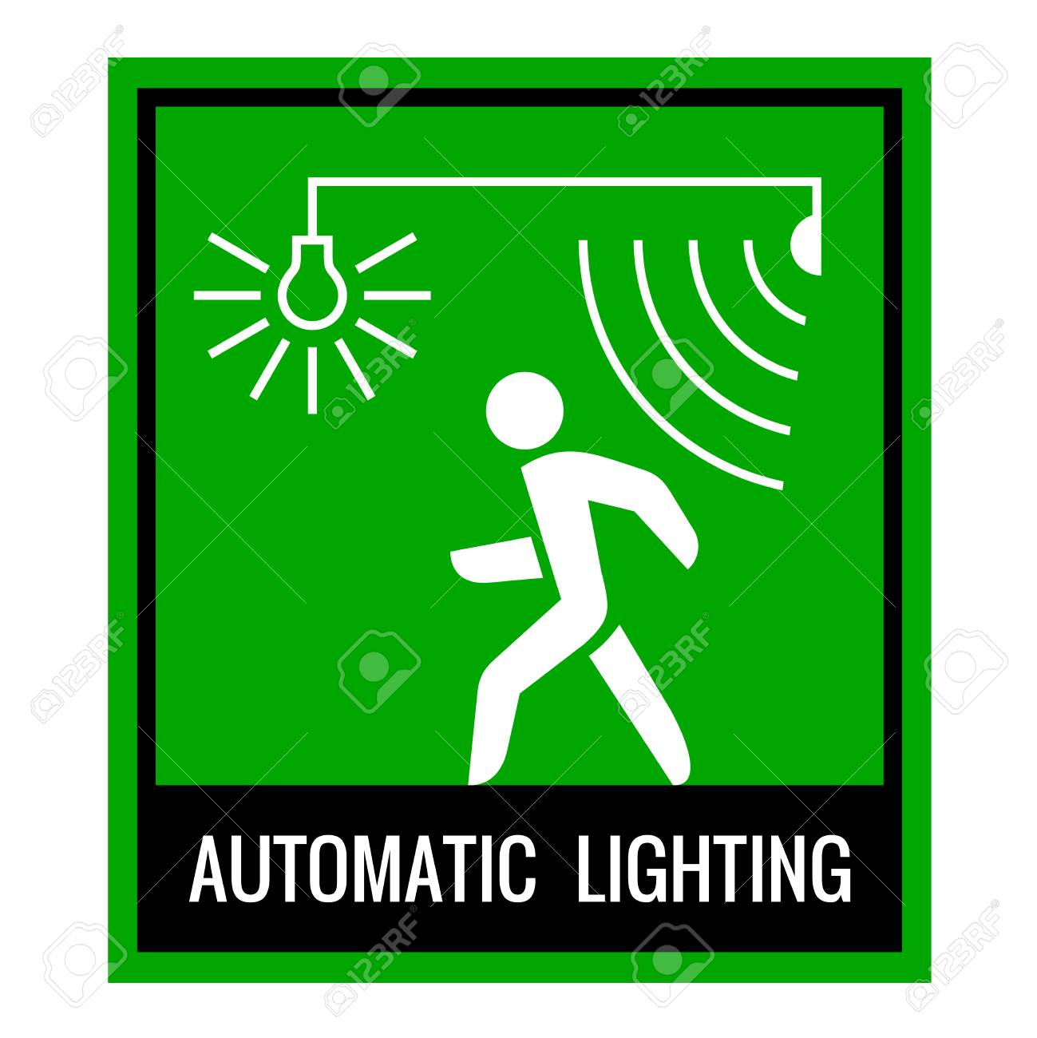
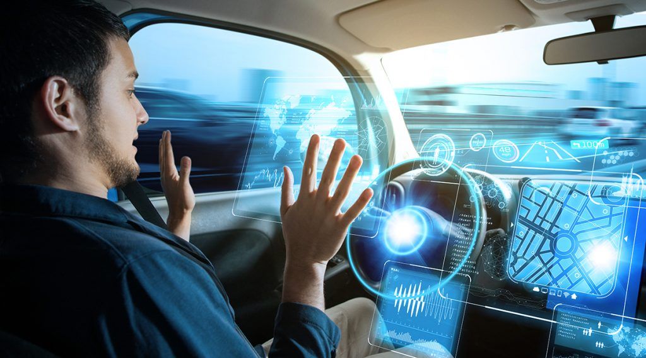
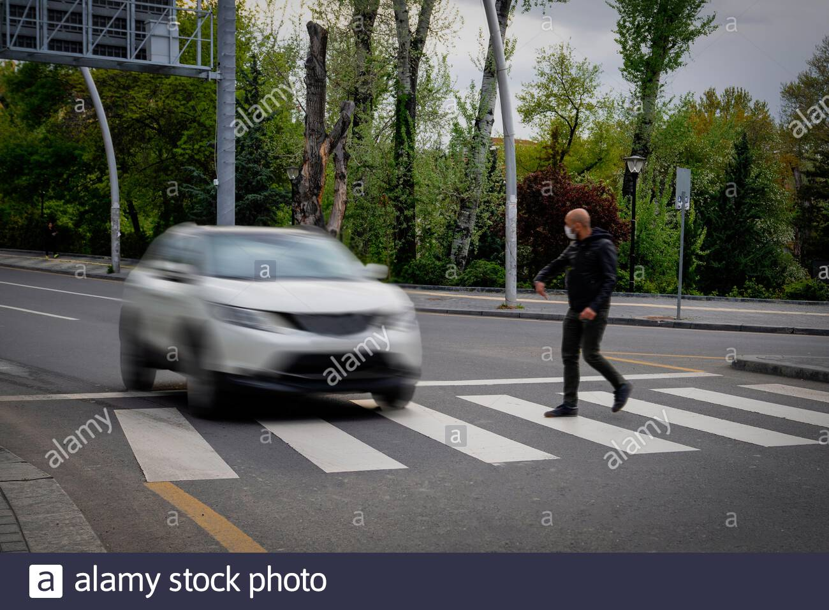
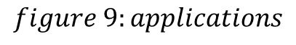
Applications
$$figure 9:applications$$

Slide 13
Future Work
Code ported to pyhton
Actuator: brakes will be applied according to the distance to collision
Use machine learning to train a model that will not require multiple video frames
Integrating with real life systems
analysis of probabilities to estimate the probability of collision

Slide 14
References
Will the Pedestrian Cross? Probabilistic Path Prediction Based on Learned Motion Features by Christoph G. Keller1, Christoph Hermes2, andDariuM. Gavrila3,4
Estimation of Walking for Pedestrian Path Prediction by Joko Hariyono, Ajmal Shahbaz and Kang-Hyun Jo
Pedestrian Intention and Pose Prediction through Dynamical Models and Behaviour Classification by R. Quintero, I. Parra, D. F. Llorca and M. A. Sotelo
Object Detection Using Correlation Technique by Ramesh Uttam Kadam, Amit Singh, Dhwani Chitalia, Pragati Upadhyay
Use of high-speed photography to track and analyze melt pool quality in selective laser sintering by Sourin Ghosh, Priti P. Rege and Manoj J. Rathod
DYNAMIC TEXTURE BASED TRAFFIC VEHICLE MONITORING SYSTEM Amit Y Kurane, Priti P Rege
Motion Detection Based On Accumulative Optical Flow and Double Background Filtering by Nan Lu, Jihong Wang, Li Yang, Henry Wu
https://nptel.ac.in/courses/117/105/117105079/
https://in.mathworks.com/discovery/object-detection.html

